Slide 1
Improving Public Decisions During Covid-19 Using Geospatial Analysis On Social Media Data
By Ali Harakeh

Slide 2
Content
Introduction
Problem Definition
Background & Related Work
Contribution
Results & Discussions
Conclusion

Slide 3
Introduction

Slide 4
Problem Definition

Slide 5
Social Media Content Languages
Language | Phrase
English | How are you?
Arabic | كيف حالك؟
Lebanese (English) | Kifak? or Kefak? or Keefak?
Lebanese (Arabic) | كيفك؟

Slide 6
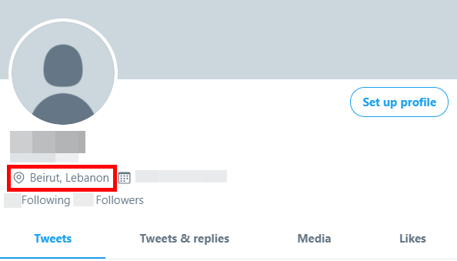
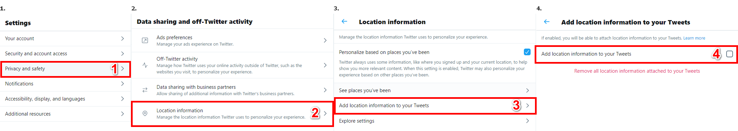
Users’ Location

Slide 7
Background & Related Work
Background
GIS
Geospatial Analysis
ArcGIS
Text Mining
Fuzzy Searching
Machine Learning

Slide 8
Background & Related Work (cont.)
Related Work
This Research
Different Social Media Platforms
Geo-Tagged social media data
Maps
Smart Dashboards
Twitter Social Media Platform
Location extraction based on users tweets and profiles
ArcGIS Online Platform for maps and dashboard

Slide 9
Contribution

Slide 10
Contribution (cont.)
Proposed Solutions
Location Extraction
Unifying Languages
Public Reactions Analysis
Sentiment Analysis
Emotions Analysis
Public Interactions Analysis
Topics Extraction
Public Activity

Slide 11
Contribution (cont.) Location Extraction

Slide 12
Location Extraction Location Data
3000+ Locations Data
English names
Arabic Names
Latitude
Longitude
Kadaa
Mohafaza

Slide 13
Location Extraction (cont.) Extracting Locations
Arabic & Lebanese-Arabic
English & Lebanese English
Both languages had the same location names.
A prefix was often added before the location name.
Some Lebanese-Arabic location names often had slight characters differences.
Both languages used the same letters but differed greatly in usage.
Both languages often had mismatched characters for the same location name.
There were many ways to write the Lebanese-English location names in.
Both languages location names often had the same sound.

Slide 14
Location Extraction (cont.) Extracting Locations (cont.)
Arabic & Lebanese-Arabic
English & Lebanese English
Word | Problem | Location Result | Method
ببيروت | Prefix “ب” | بيروت | Partial sub-string search
تل اخضر | Missing “ال” in “اخضر” | تل الاخضر | Levenshtein Distance Formula (Edit Distance)
Word | 4-digit Soundex Codex
Beirut | B630
Beyrut | B630
Beyrouth | B630
بيروت | 000ب (Doesn’t work for Arabic)
Word 1 | Word 2 | Edit Distance
Beirut | Beyrut | 1 edit(s) required
Beirut | Beyrouth | 3 edit(s) required
Beyrut | Beyrouth | 2 edit(s) required

Slide 15
Contribution (cont.) Unifying Languages

Slide 16
Unifying Languages Google Translate
Good Results, But:
Lebanese | Google Translate
Kn mnsab bas sa7 halla2 | Be the position, but correct Hala
Eh walla nsab bl marad | Uh, not lineage, but murad
Wasfi men edoctoor | My description is from Adster

Slide 17
Unifying Languages (cont.) Translating Lebanese Language
Lebanese-Arabic
Lebanese English
Lebanese | Translation
مرحبا | Hello
كيفك | How are you
تمام | Ok
منيح | Good
Lebanese | English
2ahwe, 2hwe, 2ahwi | Coffee
Adiim, Adiime, Adeem, Adeeme | Old
Jeser | Bridge
7arara | Temperature
LB | LB-AR | AR | EN
mr7aba | مرحابا | مرحبا | Hello
2hla | اهلا | اهلا | Welcome
2hwe | اهوي | اهوي | Ahoy
LB | EN | Word | Similarity
Hone | Here | Hon | 86%
2hwi | Coffee | 2ahwi | 89%
Kifak | How are you | Kefak | 80%

Slide 18
Contribution (cont.) Data Analysis

Slide 19
Data Analysis Workflow
Public Activity
Reactions
Sentiment Analysis
Emotion Analysis
Interactions
Topic Extraction
Public Interactions

Slide 20
Data Analysis (cont.) Sentimental Analysis
Goal: Observe whether people were accepting or complaining about their situation as taking any new measures for the pandemic without knowing how it would affect the public negatively or positively should never happen.
Details:
Already known Natural Language Processing (NLP) method.
TextBlob for text categorization (positive, negative, and neutral)

Slide 21
Data Analysis (cont.) Emotion Analysis
Goal: Take appropriate measures to keep people as hopeful and positive as much as possible since the overflow of negative emotions would cause public disruption and social upset.
Details:
Searching for words that referenced any emotion of the eight basic emotions (anger, disgust, fear, sadness, surprise, anticipation, joy, and trust)
A list of ~14,000 words that reference these eight emotions from the National Research Council Canada (NRC).

Slide 22
Data Analysis (cont.) Topic Extraction
Goal: Dig deep into the data and observe how people interacted with each other to get more insights.
Details:
Cleaning Data (non-alphabets, spelling mistakes, and lemmatizing)
Creating Stopwords (English, Arabic, and Twitter specific)
N-grams (Bi-grams & Tri-grams)
Manual Filtering

Slide 23
Data Analysis (cont.) Public Interactions
Goal: Find any public activity that contributed to the sudden increase of Covid-19 cases where it lead people to gather and have close contact with others.
Details:
Refering to Covid-19 reports to find when and where people interacted with each others the most.
Filtering the results ranges and get trending topics with their tweets.
Building the Geo-Database.

Slide 24
Results & Discussions

Slide 25
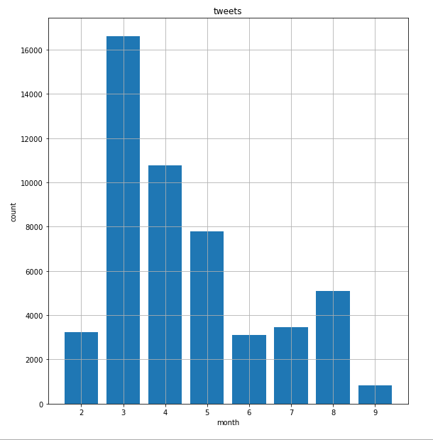
Results & Discussions (cont.) Tweets Sample Data

Slide 26
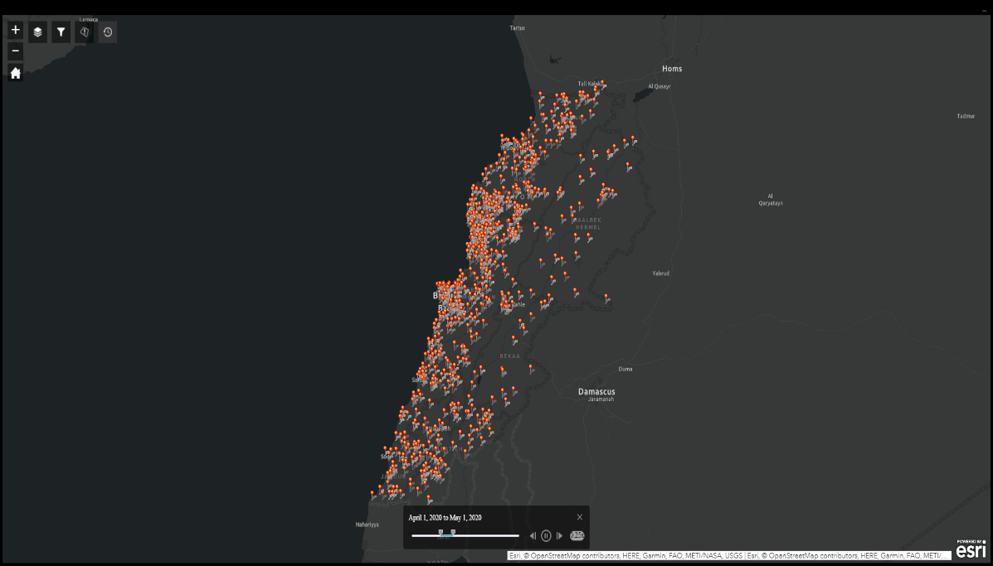
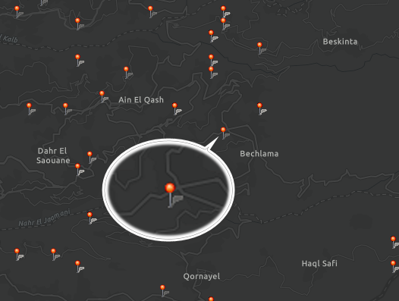
Results & Discussions (cont.) Locations

Slide 27
Results & Discussions (cont.) Unifying Locations
Lebanese | Google Translate | Tool
kn mnsab bas sa7 halla2 | Be the position, but correct Hala | was Position enough correct now
eh walla nsab bl marad | Uh, not lineage, but murad | yes indeed set up at disease
wasfi men edoctoor | My description is from Adster | prescription from doctor

Slide 28
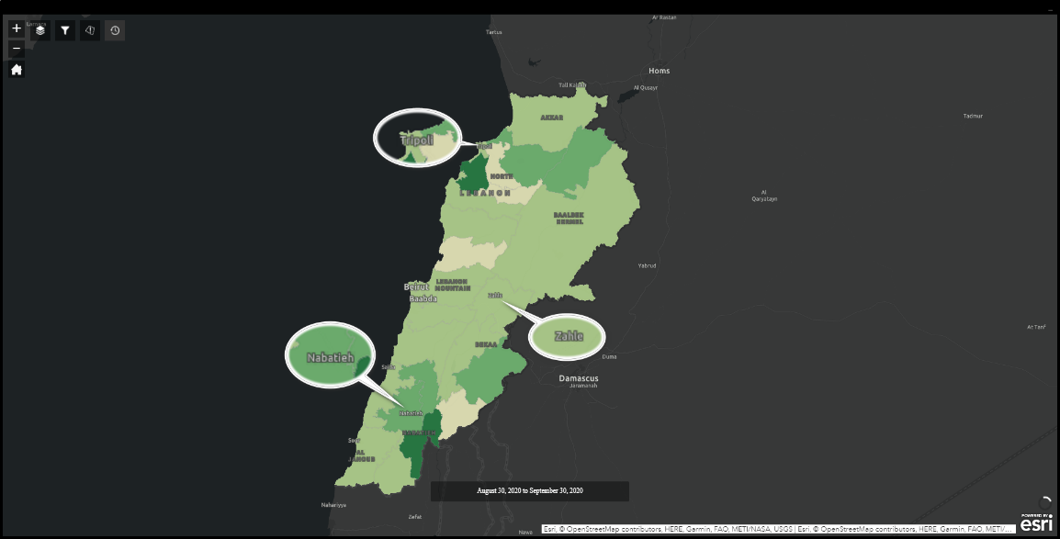
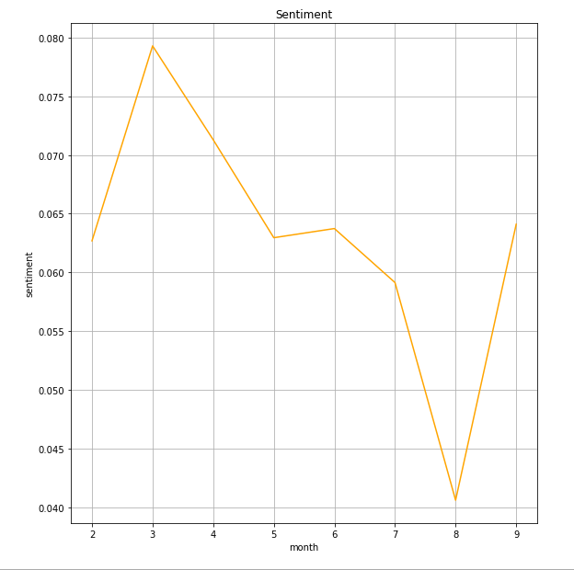
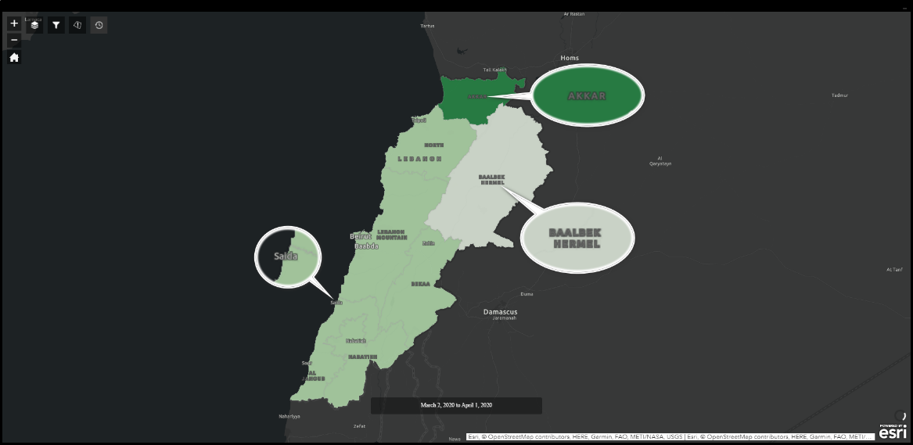
Results & Discussions (cont.) Sentiment Analysis

Slide 29
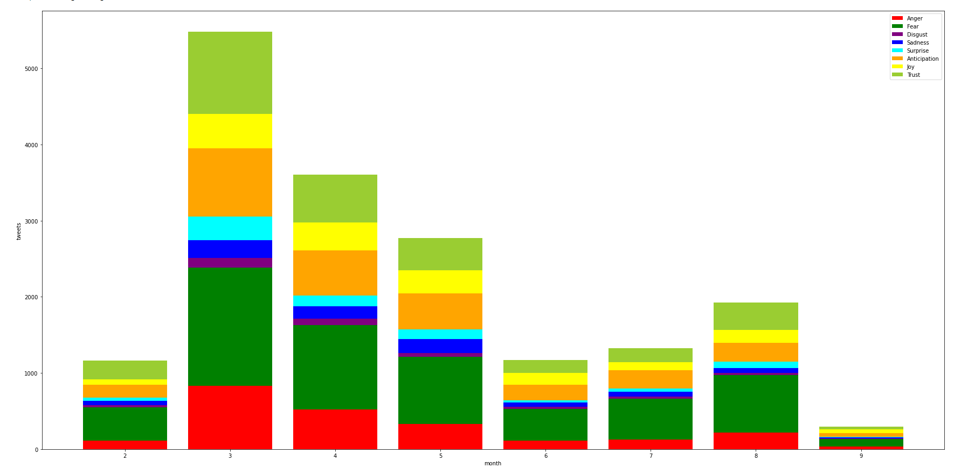
Results & Discussions (cont.) Emotions Analysis

Slide 30
Results & Discussions (cont.) Topics Extraction
Month | Mohafaza | Topics
6 | الجنوب | Syrian refugees | #كورونا #لبنان | #كورونا #كورونا_لبنان | medical marijuana | #خليك_بالبيت #كورونا_لبنان | حسان دياب | #كورونا_فايروس #مدينة_صور | marijuana dispensary | #مدينة_صور #جنوب_لبنان | وزير الداخلية
Month | Kadaa | Topics
4 | بيروت | #كورونا #لبنان | #كورونا_لبنان #خليك_بالبيت | فيروس كورونا | جديدة بفيروس | إصابة جديدة | medical cannabis | #كورونا #لبنان_ينتفض

Slide 31
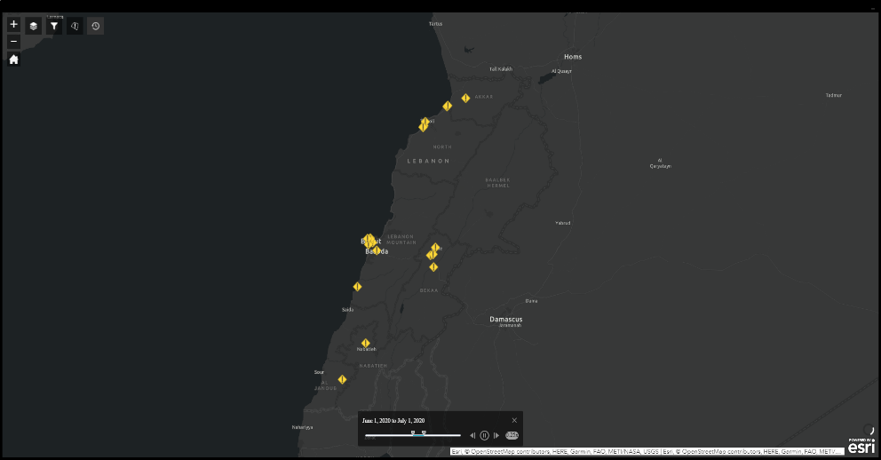
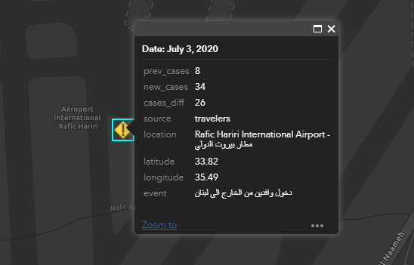
Results & Discussions (cont.) Public Activities
Date | Source | Location | Event
4/8/2020 | travelers | Rafic Hariri International Airport - مطار بيروت الدولي | دخول وافدين من الخارج الى لبنان
8/19/2020 | locals | مار مخايل - بيروت | اعمال ازالة الركام في محيط مرفا بيروت

Slide 32
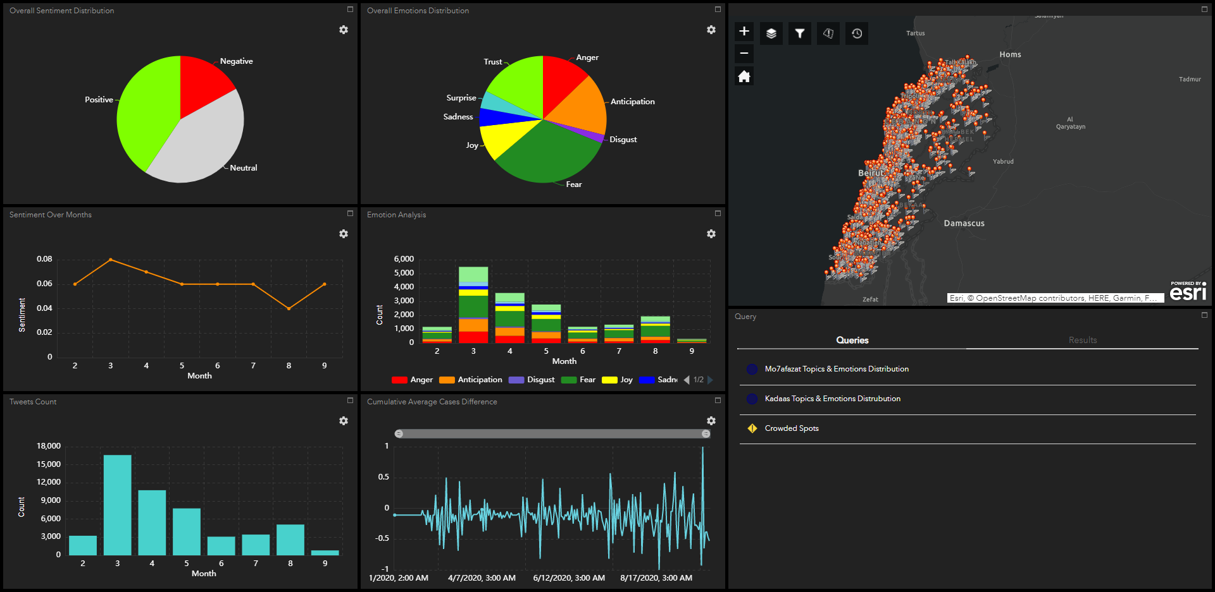
Results & Discussions (cont.) Dashboard

Slide 33
Conclusion

